Slide 1

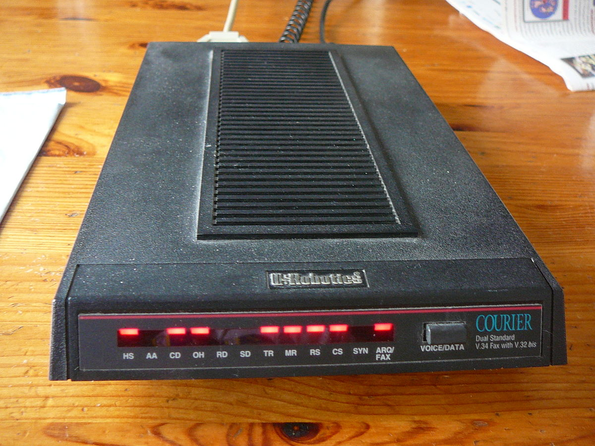
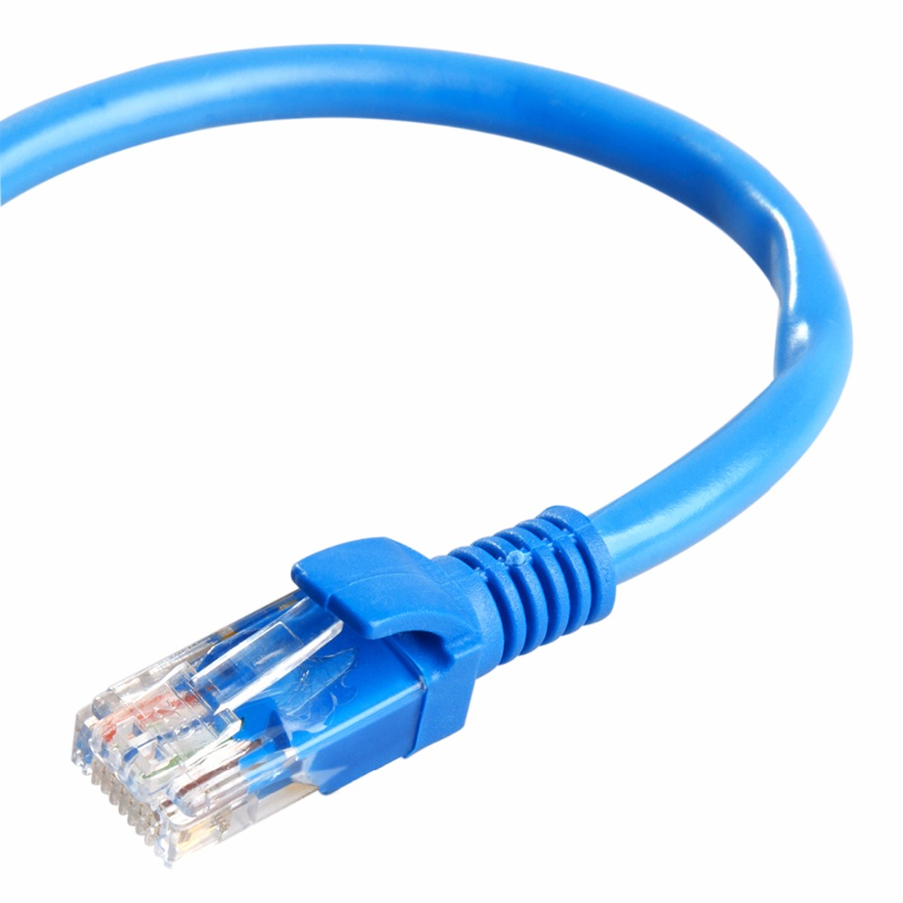
History of Dial-Up Internet/ Ethernet Internet
By: Bikram Bajwa

Slide 2
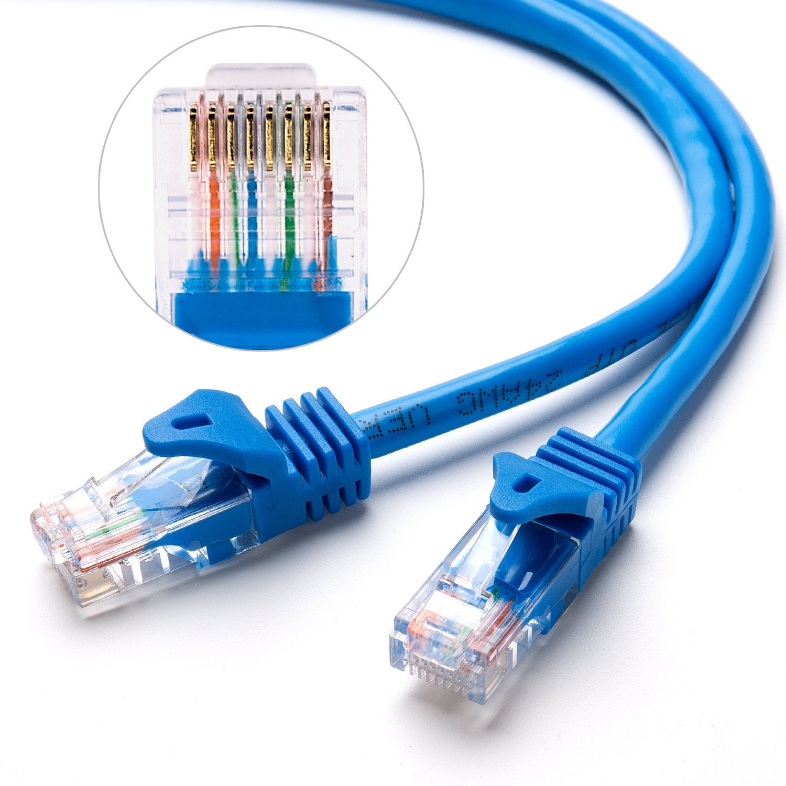
What is Dial-Up Internet/Ethernet Internet
Connection | Bitrate
110 baud (Bell 101) | 0.1 kbit/s
300 baud (Bell 103 or V.21) | 0.3 kbit/s
1200 baud (Bell 212A or V.22) | 1.2 kbit/s
2400 baud (V.22bis) | 2.4 kbit/s
2400 baud (V.26bis) | 2.4 kbit/s
4800 baud (V.27ter) | 4.8 kbit/s
9600 baud (V.32) | 9.6 kbit/s
14.4 kbit/s (V.32bis) | 14.4 kbit/s
28.8 kbit/s (V.34) | 28.8 kbit/s
33.6 kbit/s (V.34) | 33.6 kbit/s
56k kbps (V.90) | 56.0/33.6 kbit/s
56k kbps (V.92) | 56.0/48.0 kbit/s
Hardware compression (V.92/V.44) | 56.0 to 320.0 kbit/s
Server-side web compression | 200.0 to 1000.0 kbit/s
Dial-Up Internet
Dial-up Internet is a form of Internet access
Using public switched telephone network (PSTN)
To establish a connection to an internet service provider (ISP)
By dialing a number on a conventional telephone line
Different Connections give different speeds
Ethernet Internet
Ethernet Internet access is a type of network cable, also used for its high-bandwidth
Its used on a wired network, at home or any business workplace
The cable connects wired devices together to a local network
It can be used for internet access or file sharing

Slide 3
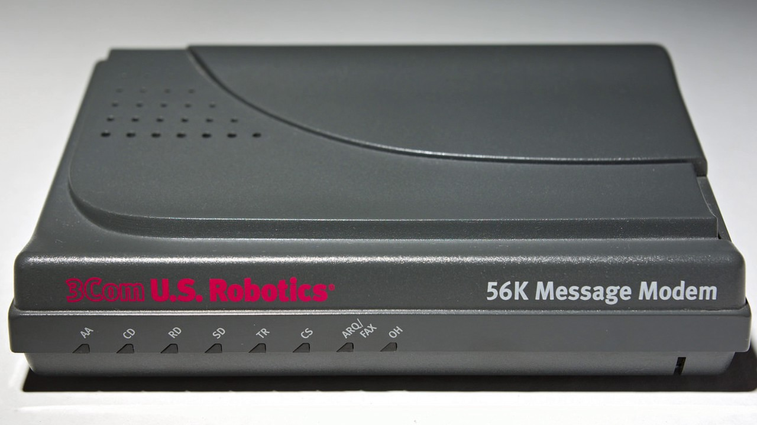
History of Dial-Up Internet
Modems:
Digital Modems were developed from the need to transmit data from the North American Air Defense in the 1950s
The data transmitted over the public switched telephone network (PSTN)
Analog telephone circuit could only transmit within its frequency
The Modem could transmit between two computers
In 1962 the first commercial Modem was made, it had a speed of 300 bits per second
In 1994 the modems speed went up to 28.8 kilobits per second
The 56k modem was invented by Dr. Brent Townshend in 1996, it had a speed of 56 kilobits per second

Slide 4
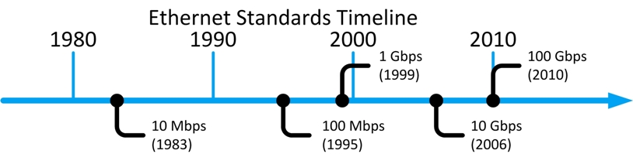
History of Ethernet Internet
Ethernet Cable:
The Ethernet cable was invented on May 22, 1973 by Bob Metcalfe
The first Ethernet cable was build by Bob Metcalfe, David Boggs, and Tat Lam in 1973
It had a speed of 2.94 Mbps
It was intended for Ethernet to create networks in small areas, called Local Area Network (LAN)
But IT departments used multiple high speed LAN networks across slower Wide Area Networks (WAN)
In 1978 Xerox made an Ethernet cable called “X-Wire” that had a speed of 10 Mbps
Today, some Ethernet cables have speeds going over 100 Gbps

